Slide 1

Nondeterministic Finite Automata
CSCI 265 Lecture 3
By Ariel Avshalom

Slide 2
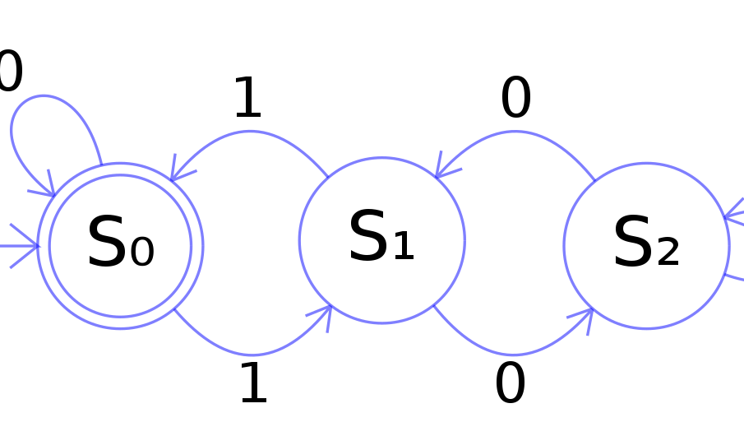
Recall
In the DFA model, every step of a computation follows in a unique way from the preceding step
When given a state and a step, we know what the next step will be
This changes in Nondeterministic Finite Automata (NFA)

Slide 3
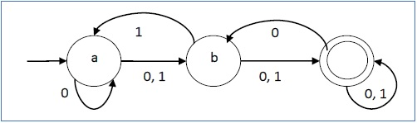
What is an NFA?
Given a symbol, several choices may be present at each state in an NFA
Instead of each step giving way to a single possible state, we have a set of possible states
This is a generalization of determinism

Slide 4
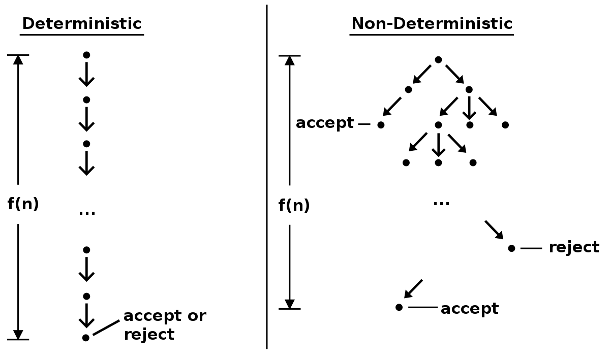
Conceptualization

Slide 5
Properties of DFA and NFA
DFA
Every state always has exactly one exiting transition arrow for each symbol in the alphabet
Labels on the transition arrows are symbols from the alphabet
NFA
In any state, there can be multiple exiting transition arrows for each symbol in the alphabet
Besides the symbols from the alphabet, there is also a ε or λ
In any given state, it is possible to not have symbols from the alphabet

Slide 6
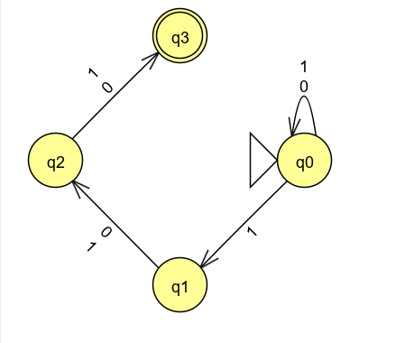
Example NFA (1.30 in book)
Let A be the language consisting of all strings over {0,1} containing a 1 in the 3rd position from the end

Slide 7
Anything a NFA can do, a DFA can do just as well!

Slide 8
NFAs and DFAs can be converted into each other
It might be messy, but they are essentially the same type of machine
So why do we care about NFAs?

Slide 9
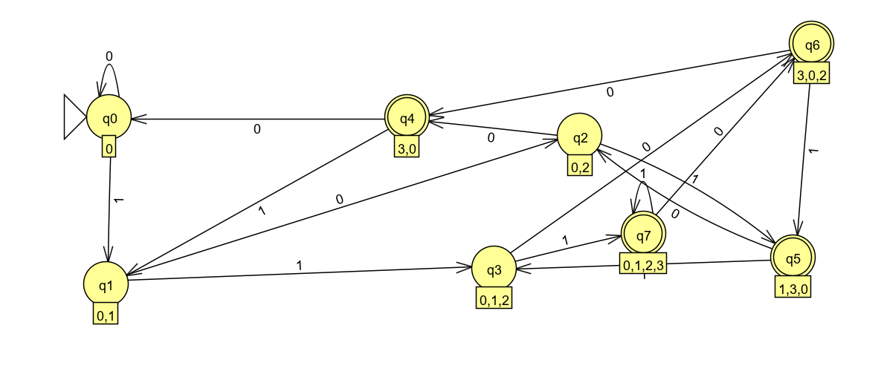
Conversion of NFA to DFA

Slide 10

Formal definition of a NFA
An NFA is defined by the following 5-tuple:
A finite set of states called (Q)
An alphabet (Σ)
A transition function ($δ:Q x Σ_{\text{ε}} →\text{𝒫}(Q)$)
A start state ($q_{0} ∈ Q$)
A set of accepting states ($F \text{⊆} Q$)

Slide 11

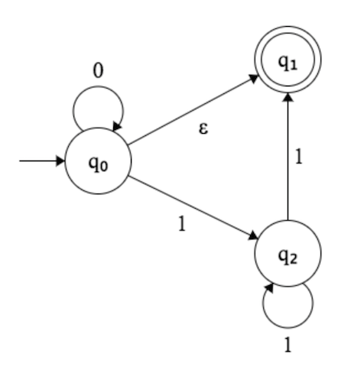

Epsilon moves?
In addition to having all the symbols of an alphabet, a NFA (or more specifically an ε-moves NFA) also has an $\text{ε}$ symbol
This allows for simultaneous state transitions without a symbol being fed into the machine

Slide 12
So what’s different?
The transition function
Two things have changed
We now have epsilon moves
We also have that powerset of Q
A transition function ($δ:Q x Σ_{\text{ε}} →\text{𝒫}(Q)$)
A transition function (𝛿:𝑄 𝑥 Σ_"ε" →"𝒫"(𝑄))

Slide 13
Closure under union
Our proof from before hasn’t changed, except now you also understand the epsilon moves
The proof is available on pages 46 and 59 of our text

Slide 14
Closure under concatenation
We will do this proof together on OneNote
It is available on page 60 of our text

Slide 15
Closure under Kleene Star
We will do this proof together on OneNote
It is available on page 62 of our text

Slide 16
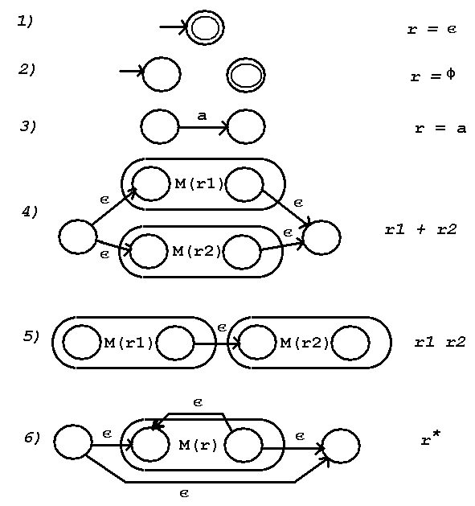
Useful chart

Slide 17
What you need to know for quiz 1
How to create a DFA
How to create an NFA
How to prove the regular operations as well as proving closure under intersection and +
How to formally define a DFA/NFA

Slide 18

Examples of NFAs
The language 1*(001+)* with 3 states
The language {$\text{ε}$} with one state
The language 0* with one state

